Slide 1

Alex Evans
@alexhevans

Slide 2
A Ratings-Based Model for Credit Risk in Maker
1. Context
2. Model Overview
3. Model Estimation
4. Risk Management Example

Slide 3
Context & Motivation

Slide 4
q_{sw}
q_{su}
Wipe
q_{uw}
Safe
Unsafe
q_{ub}
Bitten
q_{us}
Notes:
𝑞_𝑖𝑗=𝑞_𝑖 𝑝_𝑖𝑗
𝑞_𝑖=−∑1_(𝑗=1 𝑗≠𝑖)^𝐾▒𝑞_𝑖𝑗

Slide 5
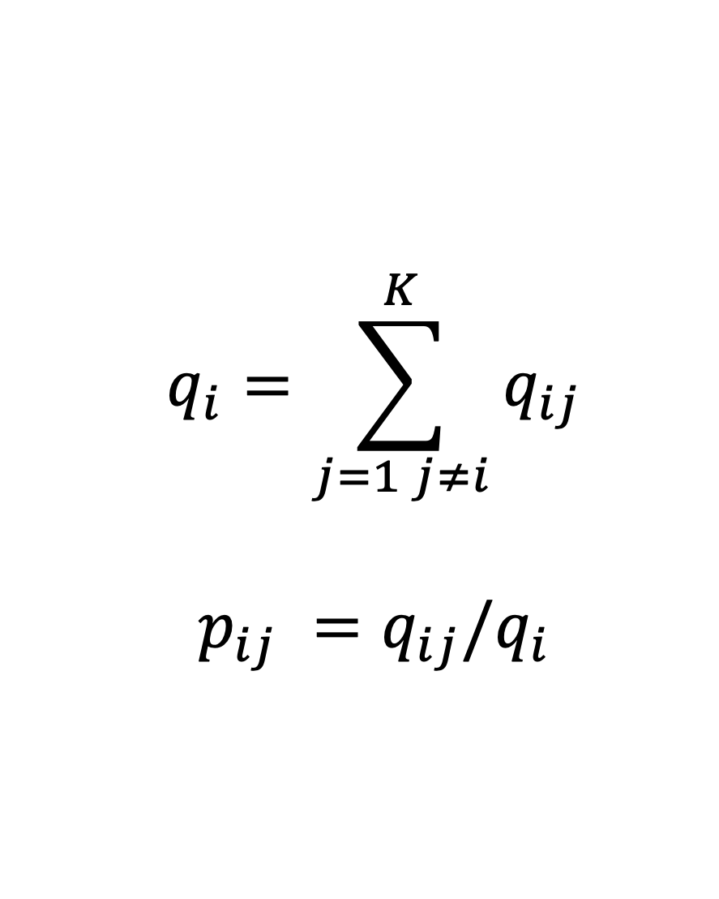

Slide 6
q_{sw} q_{sb} q_{su} q_{us} q_{uw} q_{ub}

Slide 7
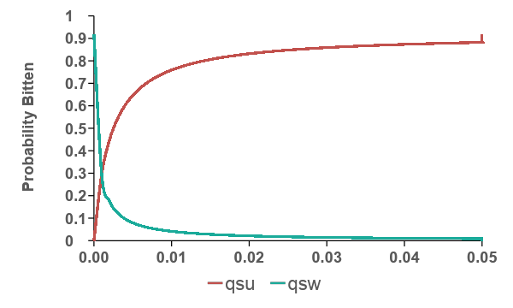


Mean Loan Lifespan
Probability Bitten

Slide 8

S
S
S
U
S
S
S
S
W
W
W
W
U
B
S
U
S
B
S
U
B
W
S
S
S
W
S
S
S
W
S
S
S
S

Slide 9
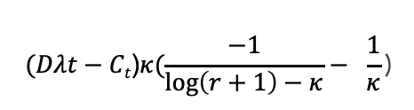

Expected Loans Outstanding
Total Stability Fees

Slide 10
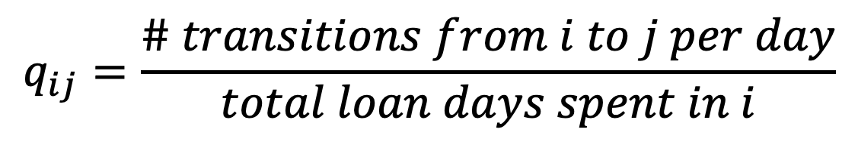

Slide 11


States | Baseline | Stability Fee | Coll 250-280% | Coll <250%
Open-Open | -0.010679 (-0.010808,-0.010552)
Open-Wiped | 0.008598 (0.008485, 0.008712) | 72.39 (59.76, 87.69) | 1.000 | 1.000
Open-Bitten | 0.002081 (0.002023, 0.002141) | 1.000 | 4.23 (4.022,4.448) | 14.29 (13.38, 15.26)

Slide 12
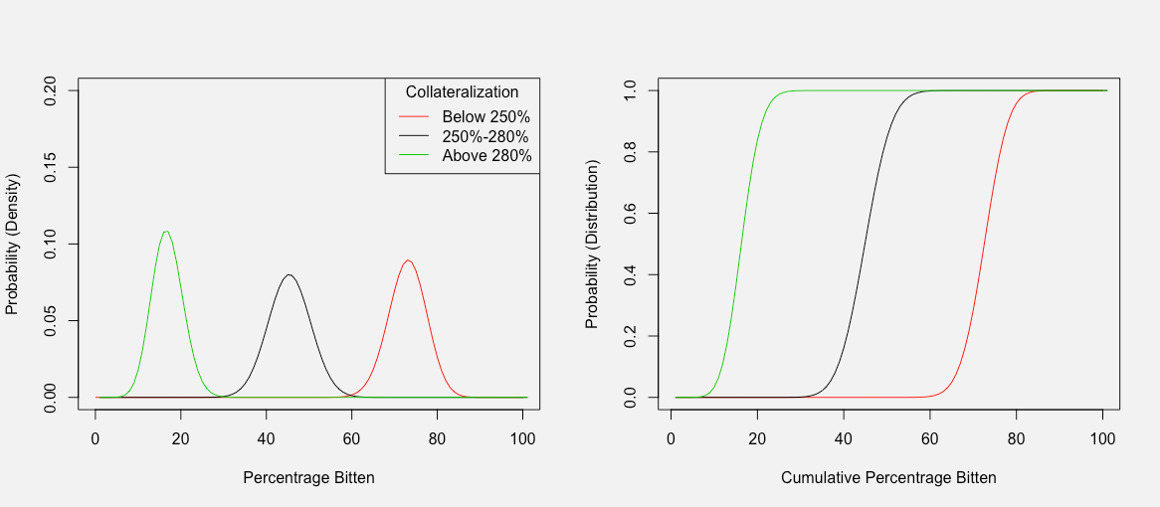
Conditional Loss Distribution

Slide 13
Alex Evans, Researcher
@alexhevans

